Slide 1

Smart Shopping Using IOT
BMS College of Engineering
Department of Information Science and Engineering
CAPSTONE PROJECT PHASE -2
Review - I
Batch No:-
Project Team Members:
Prajwal Kulkarni - 1BM18IS067
Pramila Dalavai - 1BM18IS068
Samarth M Hathwar- 1BM18IS088
Under the Guidance of
Sindhu K
(Asst. Prof)
Department of ISE

Slide 2
Agenda
Introduction
Problem Statement
Proposed System
System Design
Methodology
Technology Stack
Implementation
References

Slide 3
Introduction
In a typical shopping mall, the crowds are frequently large, especially during festival season, and billing time will grow proportionately.
As a result, the smart shopping system's primary goal is to lessen shopping time.
Customers can create their own invoices, making it simple for them to estimate their bill.
Smart shopping can also help in eliminating manual labor.
This strategy can help you save money, and the money you save can be used to improve the quality and experience of your customers.In addition, instead of counters, more products can be placed.

Slide 4
Objectives
The system provides solutions to improve the speed of purchasing of products and faster payment options. This offers a technology oriented, low-cost, easily scalable, and rugged system for assisting shopping in person. No ‘line of sight’ is required in case of RFID that reduces the labor required to scan the product.

Slide 5
Proposed System
The aim of this project is to provide an automated billing system using RFID technology. Eliminates “line of sight” scanning, by replacing barcode scanner with RFID reader that can detect products within a certain range, and without having to scan items individually.
The RFID information is processed through the microcontroller and the data is sent to the server. The server reads the request and makes necessary updates/additions to the database. The bill details are then broadcasted to the mobile application from the database and the checkout is processed.

Slide 6
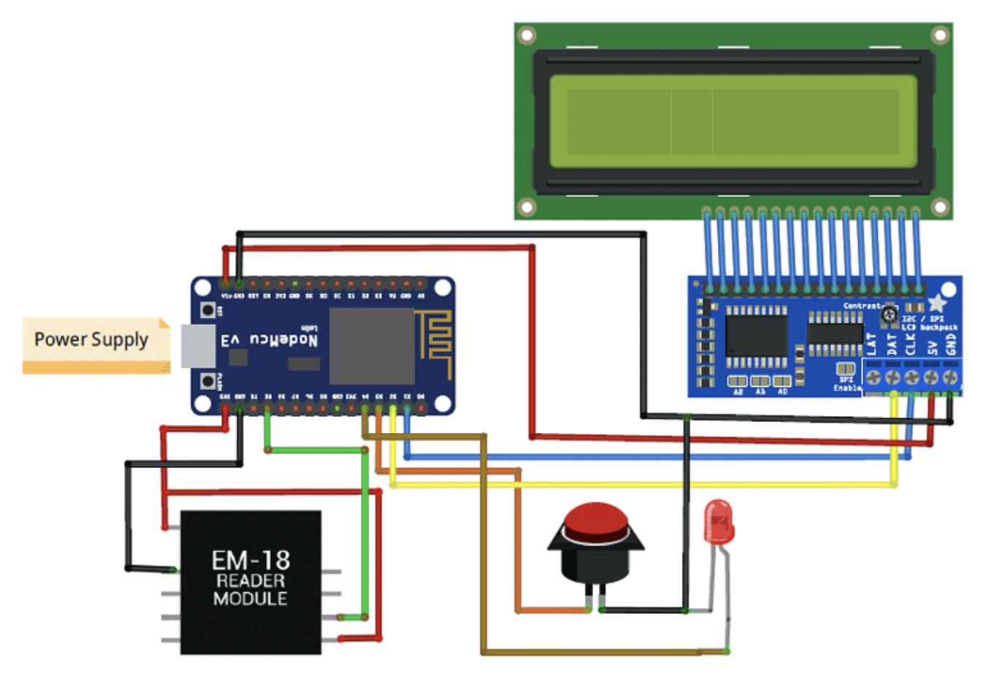
CIRCUIT DIAGRAM
Tell about
System Architecture

Slide 7
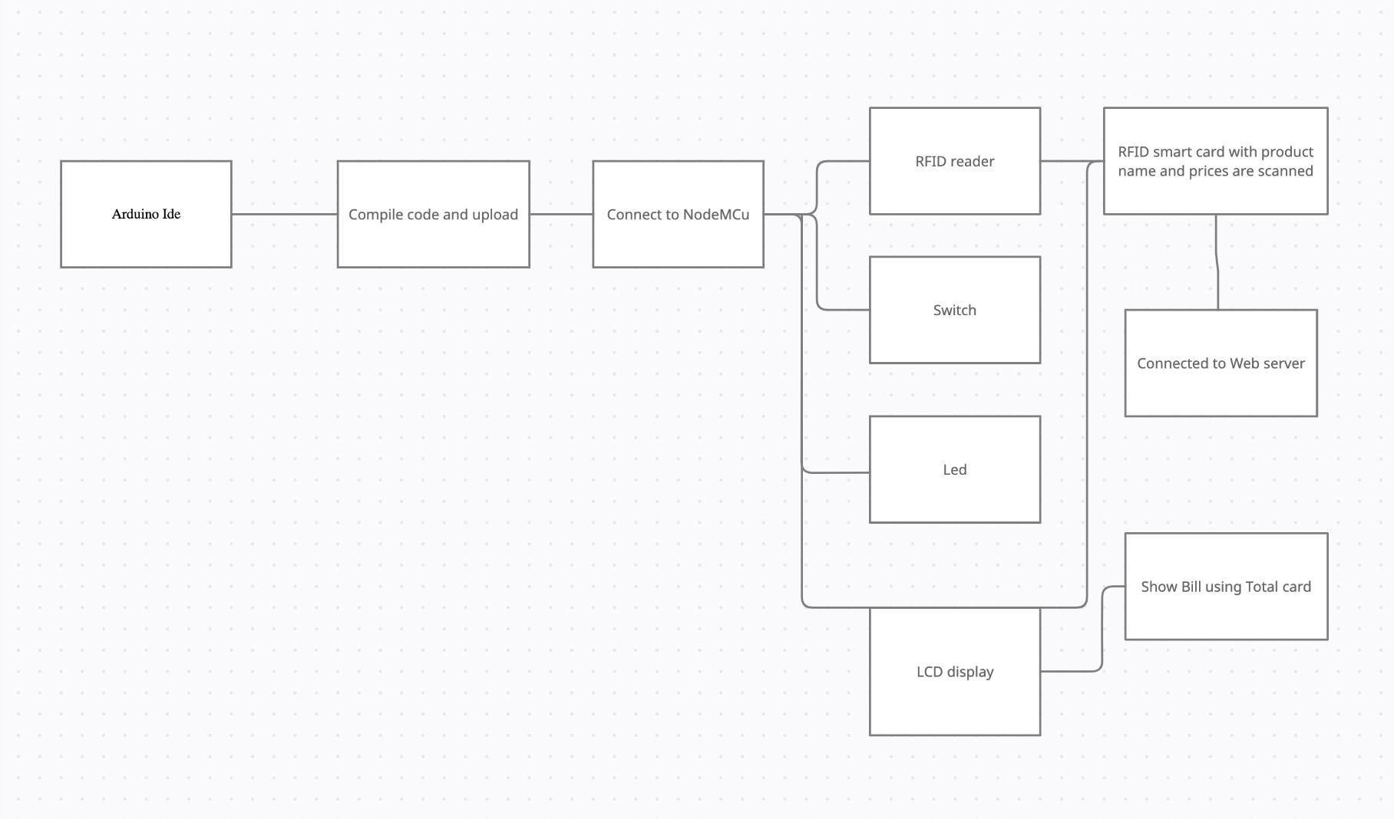
SYSTEM DESIGN

Slide 8
Methodology
The Smart Shopping Cart project is built with RFID cards and RFID scanners with NodeMCU.
The total value and cart information will be displayed on both the internet and the LCD. Each RFID card is associated with a specific product, and an RFID reader is mounted in the cart, which reads and communicates product information to the NodeMCU ESP8266.
The available products and total amount in the cart are then processed by NodeMCU and sent to the ESP8266 Webserver, which can be seen using a web browser.

Slide 9
Technology Stack
Database - Mysql
Programming language - Embedded C
Platform - Arduino Ide
Interfaces - Webserver, Html , Css, Javascript

Slide 10
Materials Used
Materials Required
ESP8266 NodeMCU -1
16*2 Alphanumeric LCD-1
I2C module for 16*2 LCD-1
4 pin Tactile switch-1
EM18 RFID Reader-1
EM18 RFID Reader Pin description:
VCC: 4.5- 5V DC voltage input
GND: Ground pin
Buzzer: Buzzer or LED pin
TX: Transmitter pin of EM18 for RS232 (Output)

Slide 11
Algorithm
The functioning of the system is explained below:
Step 1: Start the system
Step 2: Swipe the user smart card (RFID TAG with prices) to initiate shopping. The user information and the available balance are displayed in the LCD display.
Step 3: Place products in the trolley.
Step 4: Display information on LCD.
Step 5: Update the billing Information.
Step 6: Product that are not needed can be taken out from the trolley using switch
Step 7: Subtract the price of product and update the detail on LCD.
Step 8: Press the ‘pay now’ button to end shopping.
Step 9: The bill amount will be deduced from the available balance in the smart card.

Slide 12
Implementation
RFID sensors with a shopping cart are proposed, that connected with Web Application makes the consumer get desirable and the best quality products in the meantime.
RFID tags contain digital data that is encoded and decoded using radio waves by an RFID reader. RFID is comparable to barcoding in that an RFID reader device decodes data from a tag.
Wireless communication will provide flexibility to the shopping and supermarket management system.The back-end supermarket management system facilitates the supermarket to personalize its shelves and products according to consumer preferences.

Slide 13
References
[1] Applications on Secure Smart Shopping System Suhas B.M1, Tanu.N.Prabhu2.
International Research Journal of Engineering and Technology (IRJET) e-ISSN: 2395-0056 Volume: 05 Issue: 02 | Feb-2018
[2] 2018, Purva S. Puranik1 , Parikshit N. Mahalle2 IoT Application on Smart and Secure Shopping System using RFID, Zig-Bee and Gossamer Protocol. International Journal of Engineering and Techniques - Volume 4 Issue 3, May - June 2018
[3] SMART SHOPPING TROLLEY USING RFID P.T. Sivagurunathan# ,P. Seema*, M. Shalini*.
International Journal of Pure and Applied Mathematics Volume 118 No. 20 2018,
[4] Binary search algorithm of RFID system in the supermarket shopping information identification.
Wu et al. EURASIP Journal on Wireless Communications and Networking (2019) 2019:27
[5] Smart Cart For Automatic Billing With Integrated Rfid System Shaikh Farhan Shahnoor1 , Ravi Kumar2 , Manish Rathore3 , Shivashish Saha4 , Raji C. Turkish Journal of Computer and Mathematics Education V ol.12 No.12 (2021), 2487-2493 Research Article 2487

Slide 14
[6] Vallabhuni, R.R., Lakshmanachari, S., Avanthi, G. and Vijay, V., 2020, December. Smart Cart Shopping System with an RFID Interface for Human Assistance. In 2020 3rd International Conference on Intelligent Sustainable Systems (ICISS) (pp. 165-169). IEEE.
[7] Athauda, T., Marin, J.C.L., Lee, J. and Karmakar, N.C., 2018. Robust low-cost UHF RFID based smart shopping trolley. IEEE journal of radio frequency identification, 2(3), pp.134-143.
[8] Li, R., Song, T., Capurso, N., Yu, J., Couture, J. and Cheng, X., 2017. IoT applications on secure smart shopping system. IEEE Internet of Things Journal, 4(6), pp.1945-1954.
[9] Nithiavathy, R., Shree, R.A., Kumar, S.P. and Raghul, S., 2021, May. Arduino enabled IoT based Smart Shopping Trolley. In Journal of Physics: Conference Series (Vol. 1916, No. 1, p. 012203). IOP Publishing.
[10] Ballestín, F., Pérez, Á., Lino, P., Quintanilla, S. and Valls, V., 2019. Static and dynamic policies with RFID for the scheduling of retrieval and storage warehouse operations. Computers & Industrial Engineering, 66(4), pp.696-709.

Slide 15
[11] M. Shahroz, M. F. Mushtaq, M. Ahmad, S. Ullah, A. Mehmood and G. S. Choi, "IoT-Based Smart Shopping Cart Using Radio Frequency Identification," in IEEE Access, vol. 8, pp. 68426-68438, 2020, doi: 10.1109/ACCESS.2020.2986681.
[12] P. Chandrasekar and T. Sangeetha, "Smart shopping cart with automatic billing system through RFID and ZigBee," International Conference on Information Communication and Embedded Systems (ICICES2014), 2014, pp. 1-4, doi: 10.1109/ICICES.2014.7033996.
[13] R. Li, T. Song, N. Capurso, J. Yu, J. Couture and X. Cheng, "IoT Applications on Secure Smart Shopping System," in IEEE Internet of Things Journal, vol. 4, no. 6, pp. 1945-1954, Dec. 2017, doi: 10.1109/JIOT.2017.2706698.
[14] T. Athauda, J. C. L. Marin, J. Lee and N. C. Karmakar, "Robust Low-Cost Passive UHF RFID Based Smart Shopping Trolley," in IEEE Journal of Radio Frequency Identification, vol. 2, no. 3, pp. 134-143, Sept. 2018, doi: 10.1109/JRFID.2018.2866087.
[15] S. Mekruksavanich, "Supermarket Shopping System using RFID as the IoT Application," 2020 Joint International Conference on Digital Arts, Media and Technology with ECTI Northern Section Conference on Electrical, Electronics, Computer and Telecommunications Engineering (ECTI DAMT & NCON), 2020, pp. 83-86, doi: 10.1109/ECTIDAMTNCON48261.2020.9090714.

